Slide 1
Shortest Paths
Presentation for use with the textbook Data Structures and Algorithms in Java, 6th edition, by M. T. Goodrich, R. Tamassia, and M. H. Goldwasser, Wiley, 2014
0
8
A
4
2
8
7
2
1
3
B
C
D
5
3
9
8
2
E
F
5

Slide 2
Weighted Graphs
In a weighted graph, each edge has an associated numerical value, called the weight of the edge
Edge weights may represent, distances, costs, etc.
Example:
In a flight route graph, the weight of an edge represents the distance in miles between the endpoint airports
849
PVD
1843
ORD
142
SFO
802
LGA
1743
1205
337
1387
HNL
2555
1099
LAX
1233
DFW
1120
MIA

Slide 3
Shortest Paths
Given a weighted graph and two vertices u and v, we want to find a path of minimum total weight between u and v.
Length of a path is the sum of the weights of its edges.
Example:
Shortest path between Providence and Honolulu
Applications
Internet packet routing
Flight reservations
Driving directions
849
PVD
1843
ORD
142
SFO
802
LGA
1743
1205
337
1387
HNL
2555
1099
LAX
1233
DFW
1120
MIA

Slide 4
Shortest Path Properties
Property 1:
A subpath of a shortest path is itself a shortest path
Property 2:
There is a tree of shortest paths from a start vertex to all the other vertices
Example:
Tree of shortest paths from Providence
849
PVD
1843
ORD
142
SFO
802
LGA
1743
1205
337
1387
HNL
2555
1099
LAX
1233
DFW
1120
MIA

Slide 5
Dijkstra’s Algorithm
The distance of a vertex v from a vertex s is the length of a shortest path between s and v
Dijkstra’s algorithm computes the distances of all the vertices from a given start vertex s
Assumptions:
the graph is connected
the edges are undirected
the edge weights are nonnegative
We grow a “cloud” of vertices, beginning with s and eventually covering all the vertices
We store with each vertex v a label d(v) representing the distance of v from s in the subgraph consisting of the cloud and its adjacent vertices
At each step
We add to the cloud the vertex u outside the cloud with the smallest distance label, d(u)
We update the labels of the vertices adjacent to u

Slide 6
Edge Relaxation
Consider an edge e = (u,z) such that
u is the vertex most recently added to the cloud
z is not in the cloud
The relaxation of edge e updates distance d(z) as follows:
d(z) ← min{d(z),d(u) + weight(e)}
d(u) = 50
10
d(z) = 75
u
e
s
z
d(u) = 50
10
d(z) = 60
u
e
s
z

Slide 7
Example
0
0
8
A
4
8
A
4
2
2
8
7
2
1
4
8
7
2
1
3
B
C
D
B
C
D
∞
3
9
∞
5
3
9
8
2
E
F
5
2
E
F
5
0
0
8
A
4
8
A
4
2
2
8
7
2
1
3
7
7
2
1
3
B
C
D
B
C
D
5
3
9
11
5
3
9
8
2
E
F
5
2
E
F
5

Slide 8
Example (cont.)
0
8
A
4
2
7
7
2
1
3
B
C
D
5
3
9
8
2
E
F
5
0
8
A
4
2
7
7
2
1
3
B
C
D
5
3
9
8
2
E
F
5

Slide 9
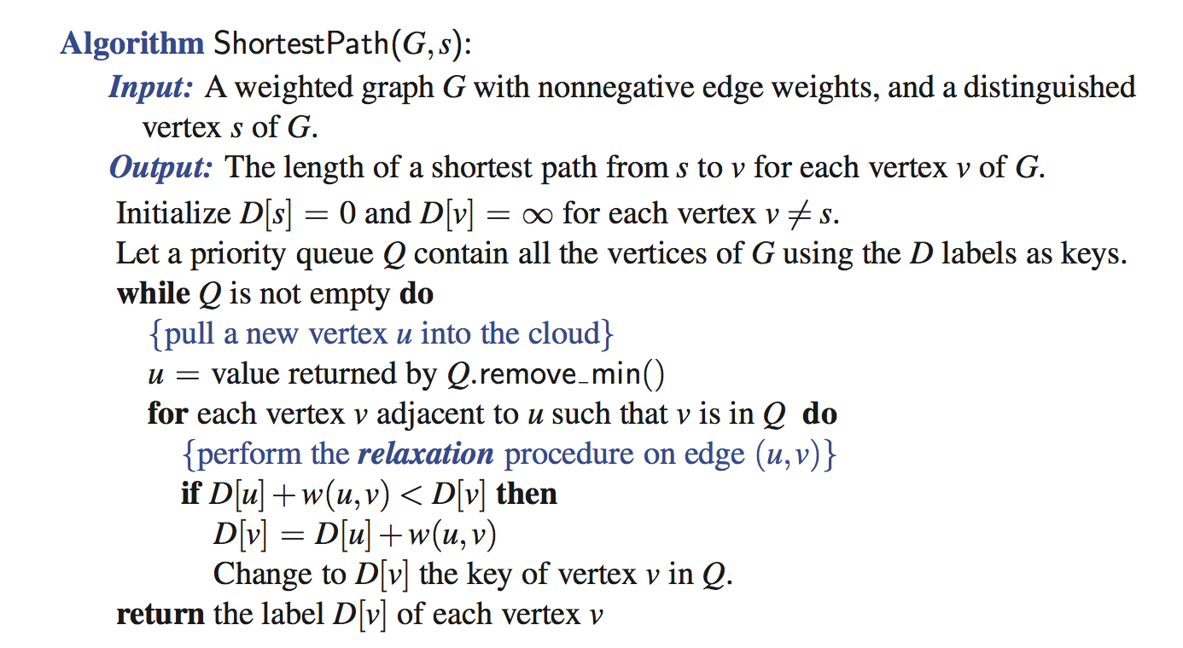
Dijkstra’s Algorithm

Slide 10
Analysis of Dijkstra’s Algorithm
Graph operations
We find all the incident edges once for each vertex
Label operations
We set/get the distance and locator labels of vertex z O(deg(z)) times
Setting/getting a label takes O(1) time
Priority queue operations
Each vertex is inserted once into and removed once from the priority queue, where each insertion or removal takes O(log n) time
The key of a vertex in the priority queue is modified at most deg(w) times, where each key change takes O(log n) time
Dijkstra’s algorithm runs in O((n + m) log n) time provided the graph is represented by the adjacency list/map structure
Recall that Σ_{v} deg(v) = 2m
The running time can also be expressed as O(m log n) since the graph is connected

Slide 11
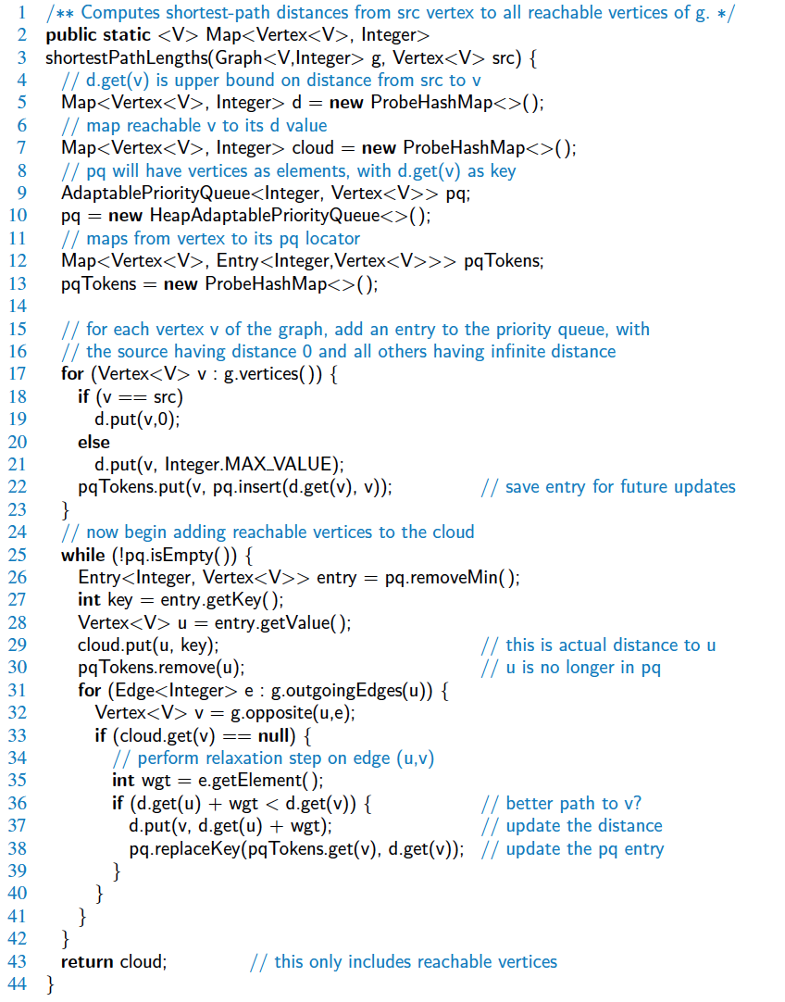
Java Implementation

Slide 12
Java Implementation, 2

Slide 13
Why Dijkstra’s Algorithm Works
Dijkstra’s algorithm is based on the greedy method. It adds vertices by increasing distance.
Suppose it didn’t find all shortest distances. Let F be the first wrong vertex the algorithm processed.
When the previous node, D, on the true shortest path was considered, its distance was correct
But the edge (D,F) was relaxed at that time!
Thus, so long as d(F)>d(D), F’s distance cannot be wrong. That is, there is no wrong vertex
0
8
A
4
2
7
7
2
1
3
B
C
D
5
3
9
8
2
E
F
5

Slide 14
Why It Doesn’t Work for Negative-Weight Edges
Dijkstra’s algorithm is based on the greedy method. It adds vertices by increasing distance.
0
8
A
4
If a node with a negative incident edge were to be added late to the cloud, it could mess up distances for vertices already in the cloud.
6
7
7
5
1
4
B
C
D
5
0
-8
9
2
E
F
5
C’s true distance is 1, but it is already in the cloud with d(C)=5!

Slide 15
Bellman-Ford Algorithm (not in book)
Works even with negative-weight edges
Must assume directed edges (for otherwise we would have negative-weight cycles)
Iteration i finds all shortest paths that use i edges.
Running time: O(nm).
Can be extended to detect a negative-weight cycle if it exists
How?
Algorithm BellmanFord(G, s)
for all v ∈ G.vertices()
if v = s
setDistance(v, 0)
else
setDistance(v, ∞)
for i ← 1 to n − 1 do
for each e ∈ G.edges()
{ relax edge e }
u ← G.origin(e)
z ← G.opposite(u,e)
r ← getDistance(u) + weight(e)
if r < getDistance(z)
setDistance(z,r)

Slide 16
Bellman-Ford Example
Nodes are labeled with their d(v) values
8
0
4
8
0
4
-2
-2
7
1
8
7
-2
1
4
∞
∞
∞
∞
∞
∞
3
9
3
9
-2
∞
∞
5
-2
∞
∞
5
8
0
4
8
0
4
-2
-2
5
8
7
-2
1
4
-1
5
7
-2
1
-1
1
3
9
3
9
-2
6
9
5
-2
4
5
∞
∞
1
9

Slide 17
DAG-based Algorithm (not in book)
Algorithm DagDistances(G, s)
for all v ∈ G.vertices()
if v = s
setDistance(v, 0)
else
setDistance(v, ∞)
{ Perform a topological sort of the vertices }
for u ← 1 to n do {in topological order}
for each e ∈ G.outEdges(u)
{ relax edge e }
z ← G.opposite(u,e)
r ← getDistance(u) + weight(e)
if r < getDistance(z)
setDistance(z,r)
Works even with negative-weight edges
Uses topological order
Doesn’t use any fancy data structures
Is much faster than Dijkstra’s algorithm
Running time: O(n+m).

Slide 18
DAG Example
Nodes are labeled with their d(v) values
1
1
8
0
4
8
0
4
-2
-2
3
7
2
1
4
3
8
7
2
-2
1
4
4
∞
∞
∞
∞
∞
∞
3
9
3
9
-5
∞
∞
5
-5
∞
∞
5
6
5
6
5
1
1
8
0
4
8
0
4
-2
-2
3
5
7
2
1
4
-1
3
7
2
1
4
8
-2
4
5
-2
-1
3
9
3
9
-5
1
7
5
-5
0
4
5
∞
∞
1
7
6
5
6
5
(two steps)

